Slide 1
Tech Interview Prep:
Architectural Styles & Event-Driven Systems
Section 1: Monolithic vs. Microservices Architectures
Section 2: Event-Driven Architecture (EDA) & Asynchronous Decoupling
Section 3: The Recommendation / Synthesis
Name: Dara Sen
Class: AD371 (Application architecture)

Slide 2
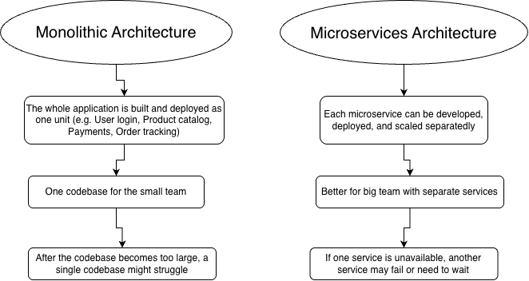
Section 1: Monolithic vs. Microservices Architectures

Slide 3
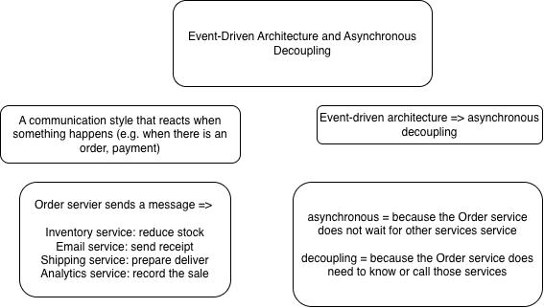
Section 2: Event-Driven Architecture (EDA) & Asynchronous Decoupling

Slide 4
Section 3: The Recommendation / Synthesis
Evolve architecture gradually (modular monolith → microservices)
Move to microservices when there are actual needs, different teams
Use event-driven architecture for work that does not need an immediate response (e.g. sending confirmation emails, updating loyalties points, etc.)

